Slide 1






Mickey Mouse
Group :
Pod :
Sahand Sadeghpour
sahand.2k.ss@gmail.com
Department of Electrical Engineering, K.N.T University of Technology, Tehran, Iran
pod-148-awesome-alpaca
● Scientific Question
How is uncertainty in decision-making reflected in mouse behavior and brainwide neural responses?
Seyed Mehrshad Hosseini
mehrshad.hosseini28@gmail.com
Department of Computer Engineering, K.N.T University of Technology, Tehran, Iran
● Dataset
Steinmetz’s dataset
Abed Khorasani
abedkh98@gmail.com
Department of Neuroscience, Kerman University of Medical Sciences, Kerman, Iran
Mentor: Dr. Farzaneh Najafi
farznaj@gmail.com
Allen Institute for Brain Science

Slide 2
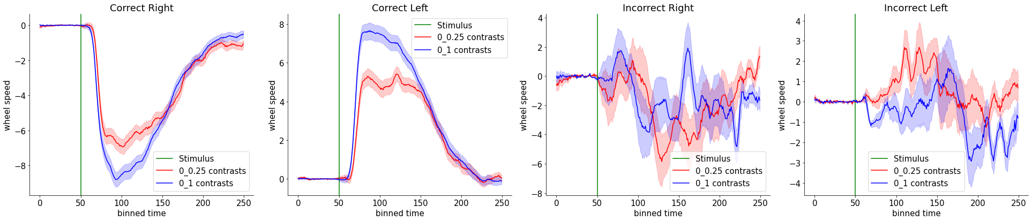
Uncertainty is reflected in animal's behavior
● Hypothesis: uncertainty in making a choice is reflected in the wheel turning speed.
● Absolute difference in stimulus contrast between the two sides was used as an uncertainty metric in the decision task: the higher the difference between the stimuli contrast, the lower the uncertainty.
● First, trials were divided into correct right, correct left, incorrect right, and incorrect left. Second, each category was divided to two conditions including stimuli with 0 - 0.25 and 0 - 1 contrasts. Finally, the mean (± standard error) wheel speed was computed by pooling all sessions and all trials for each condition.
Results:
1) wheel speed was faster in correct trials compared to incorrect trials.
2) wheel speed was faster in 0-1 contrast compared to 0-0.25 contrast.
Bin size: 10 ms

Slide 3
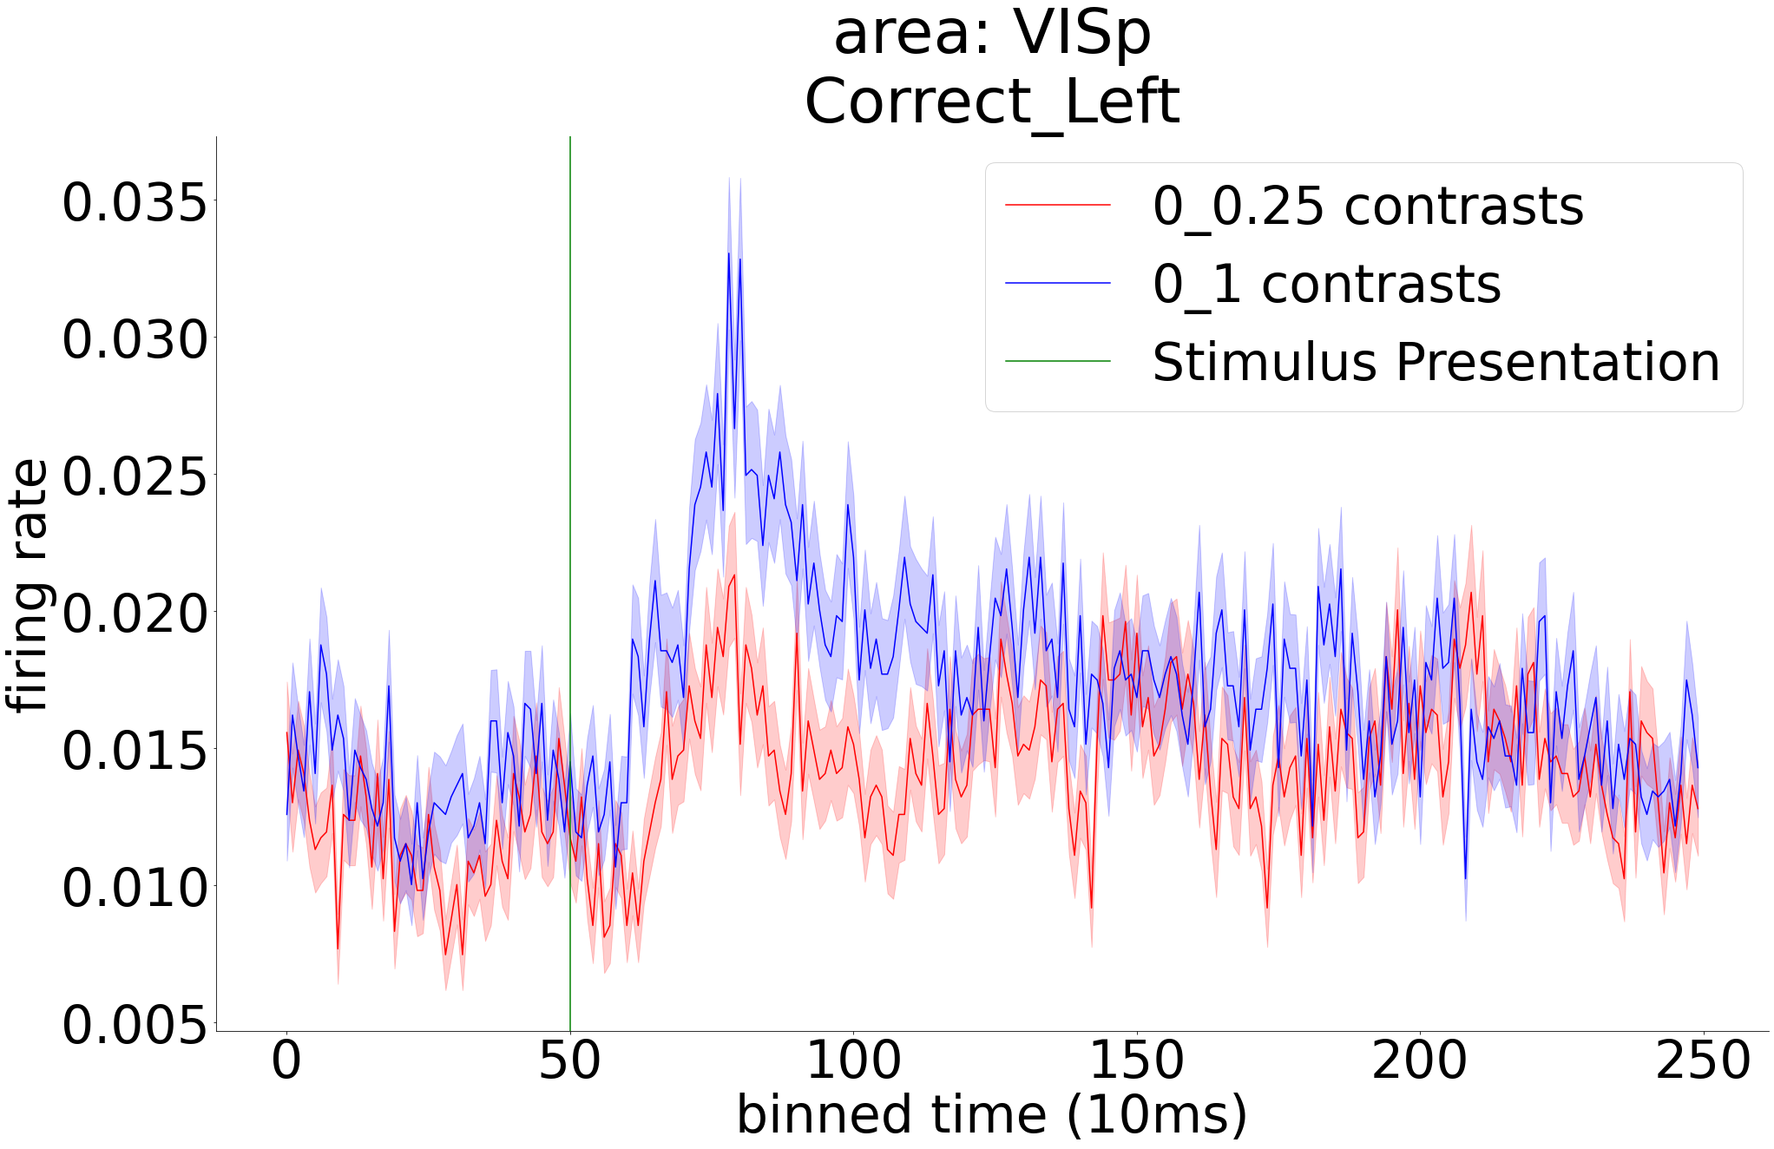
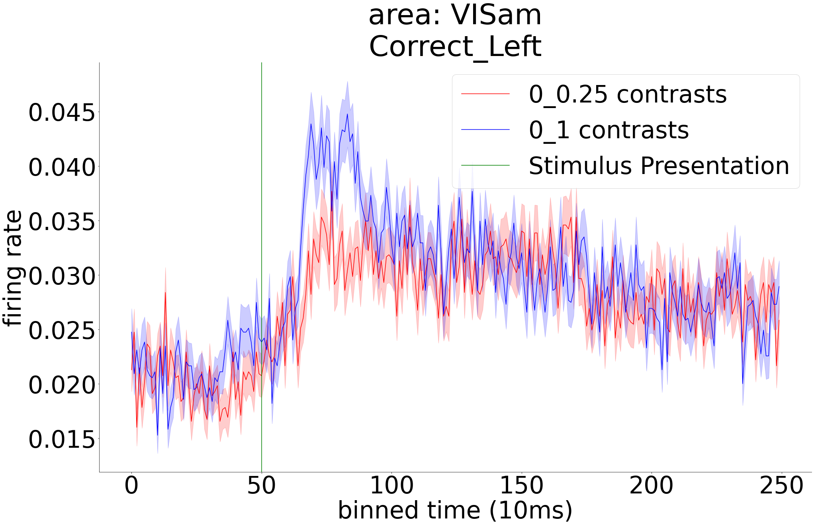
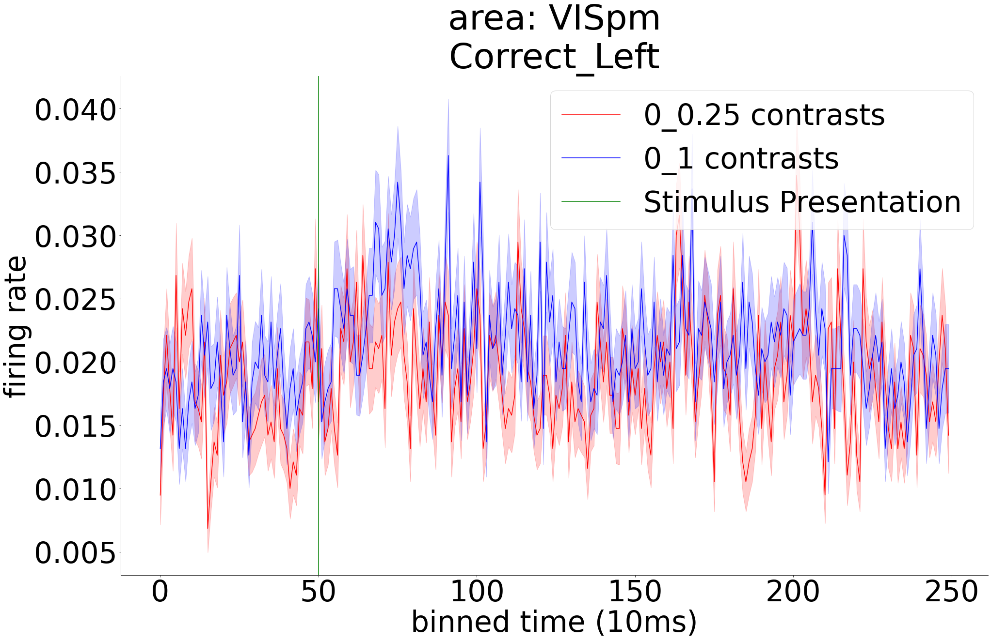
Uncertainty modifies brainwide neural responses
Neural responses of diverse brain areas were investigated to find brain regions whose activity is modified by uncertainty.
Similar to behavioral study, trials were divided into 0 - 0.25 and 0 - 1 contrasts, representing high and low uncertainty levels, respectively. To control for potential choice and outcome effects, we used only correct left trials (ipsilateral to the recording sites).
Mean (± standard error) of neural responses for the certain and uncertain conditions was computed for all brain areas. A number of examples corresponding to visual, frontal, midbrain and other areas are shown below and in the next slide.
Visual
Areas

Slide 4
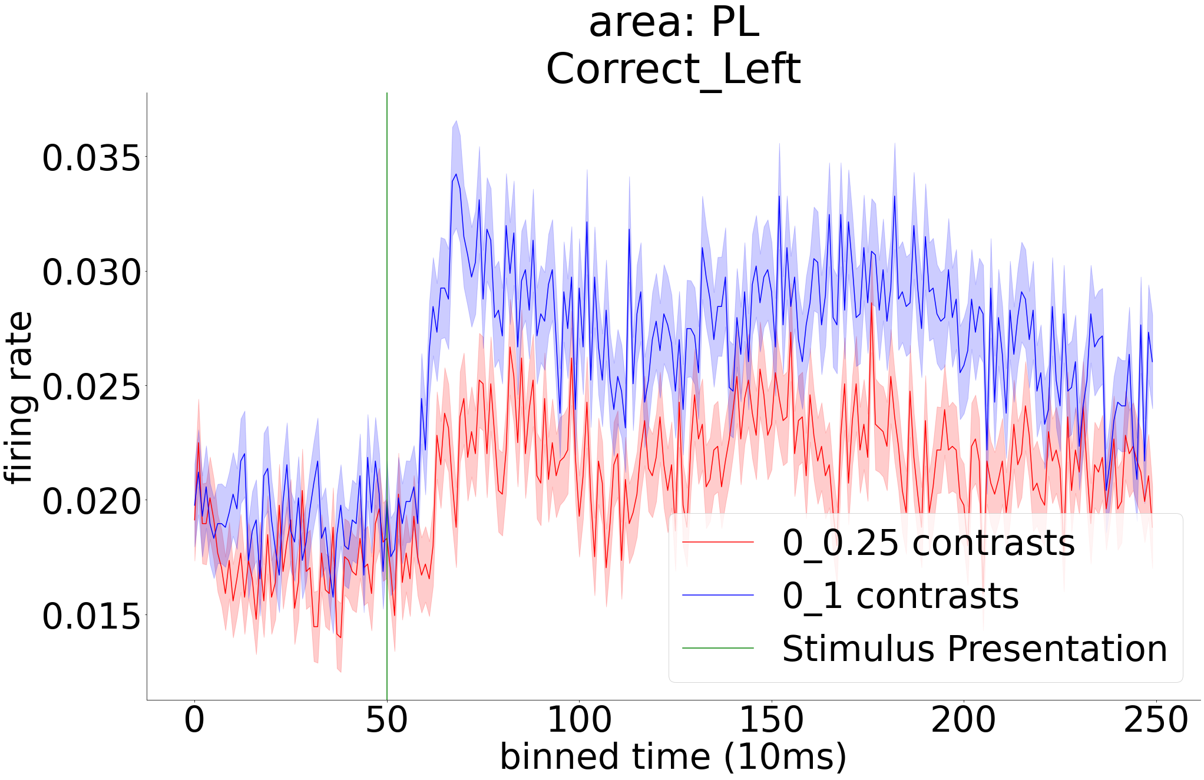
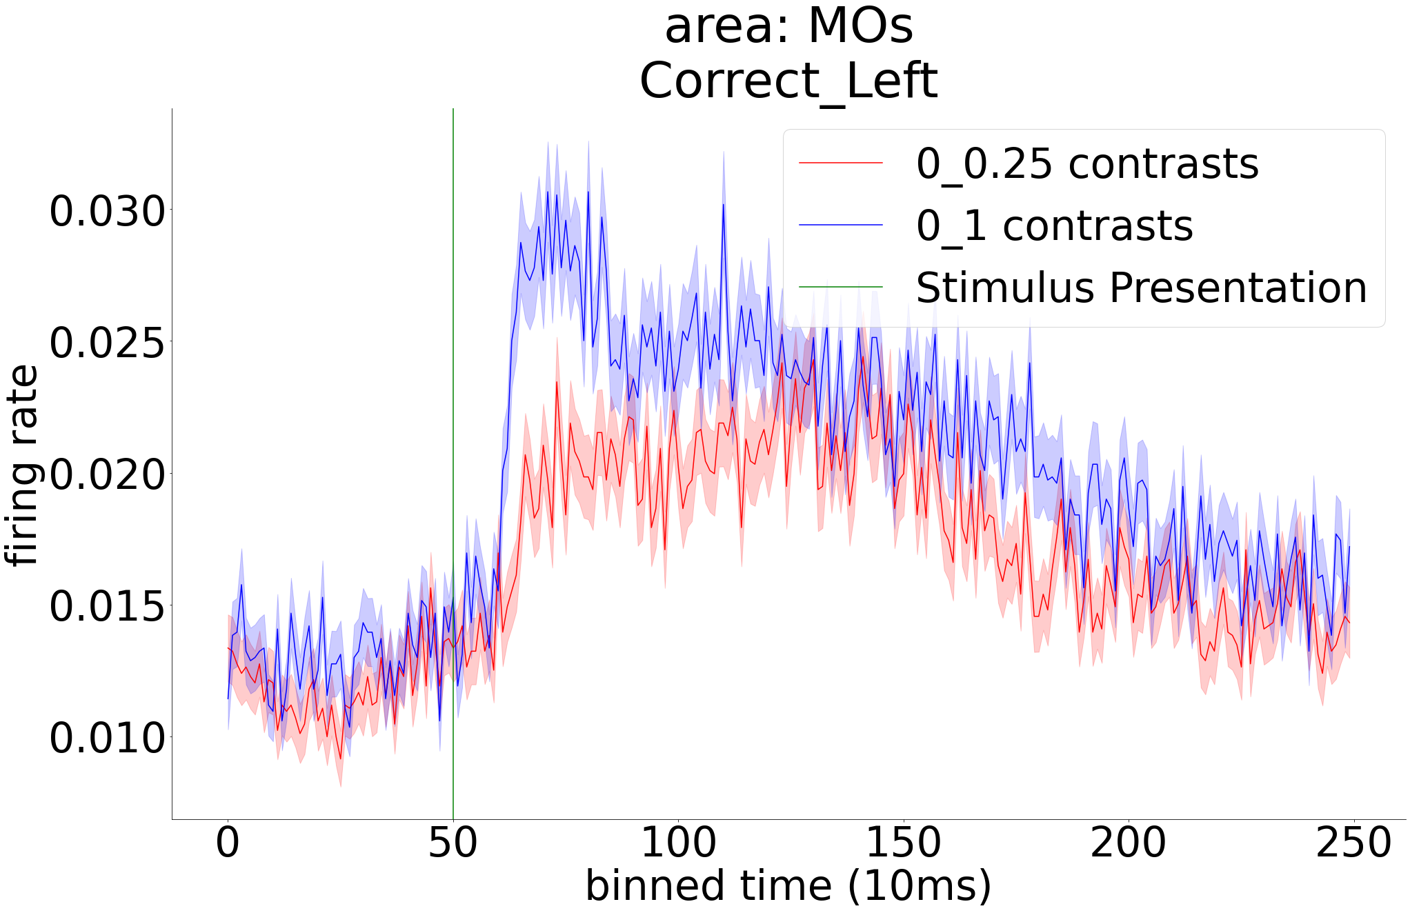
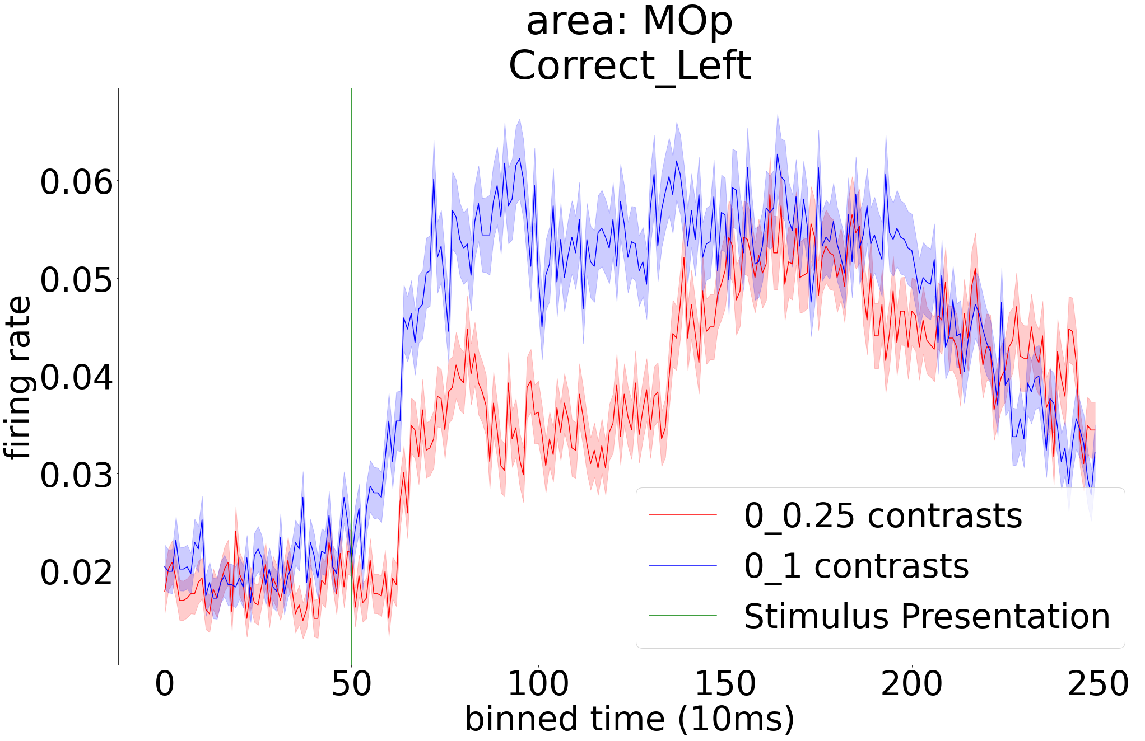
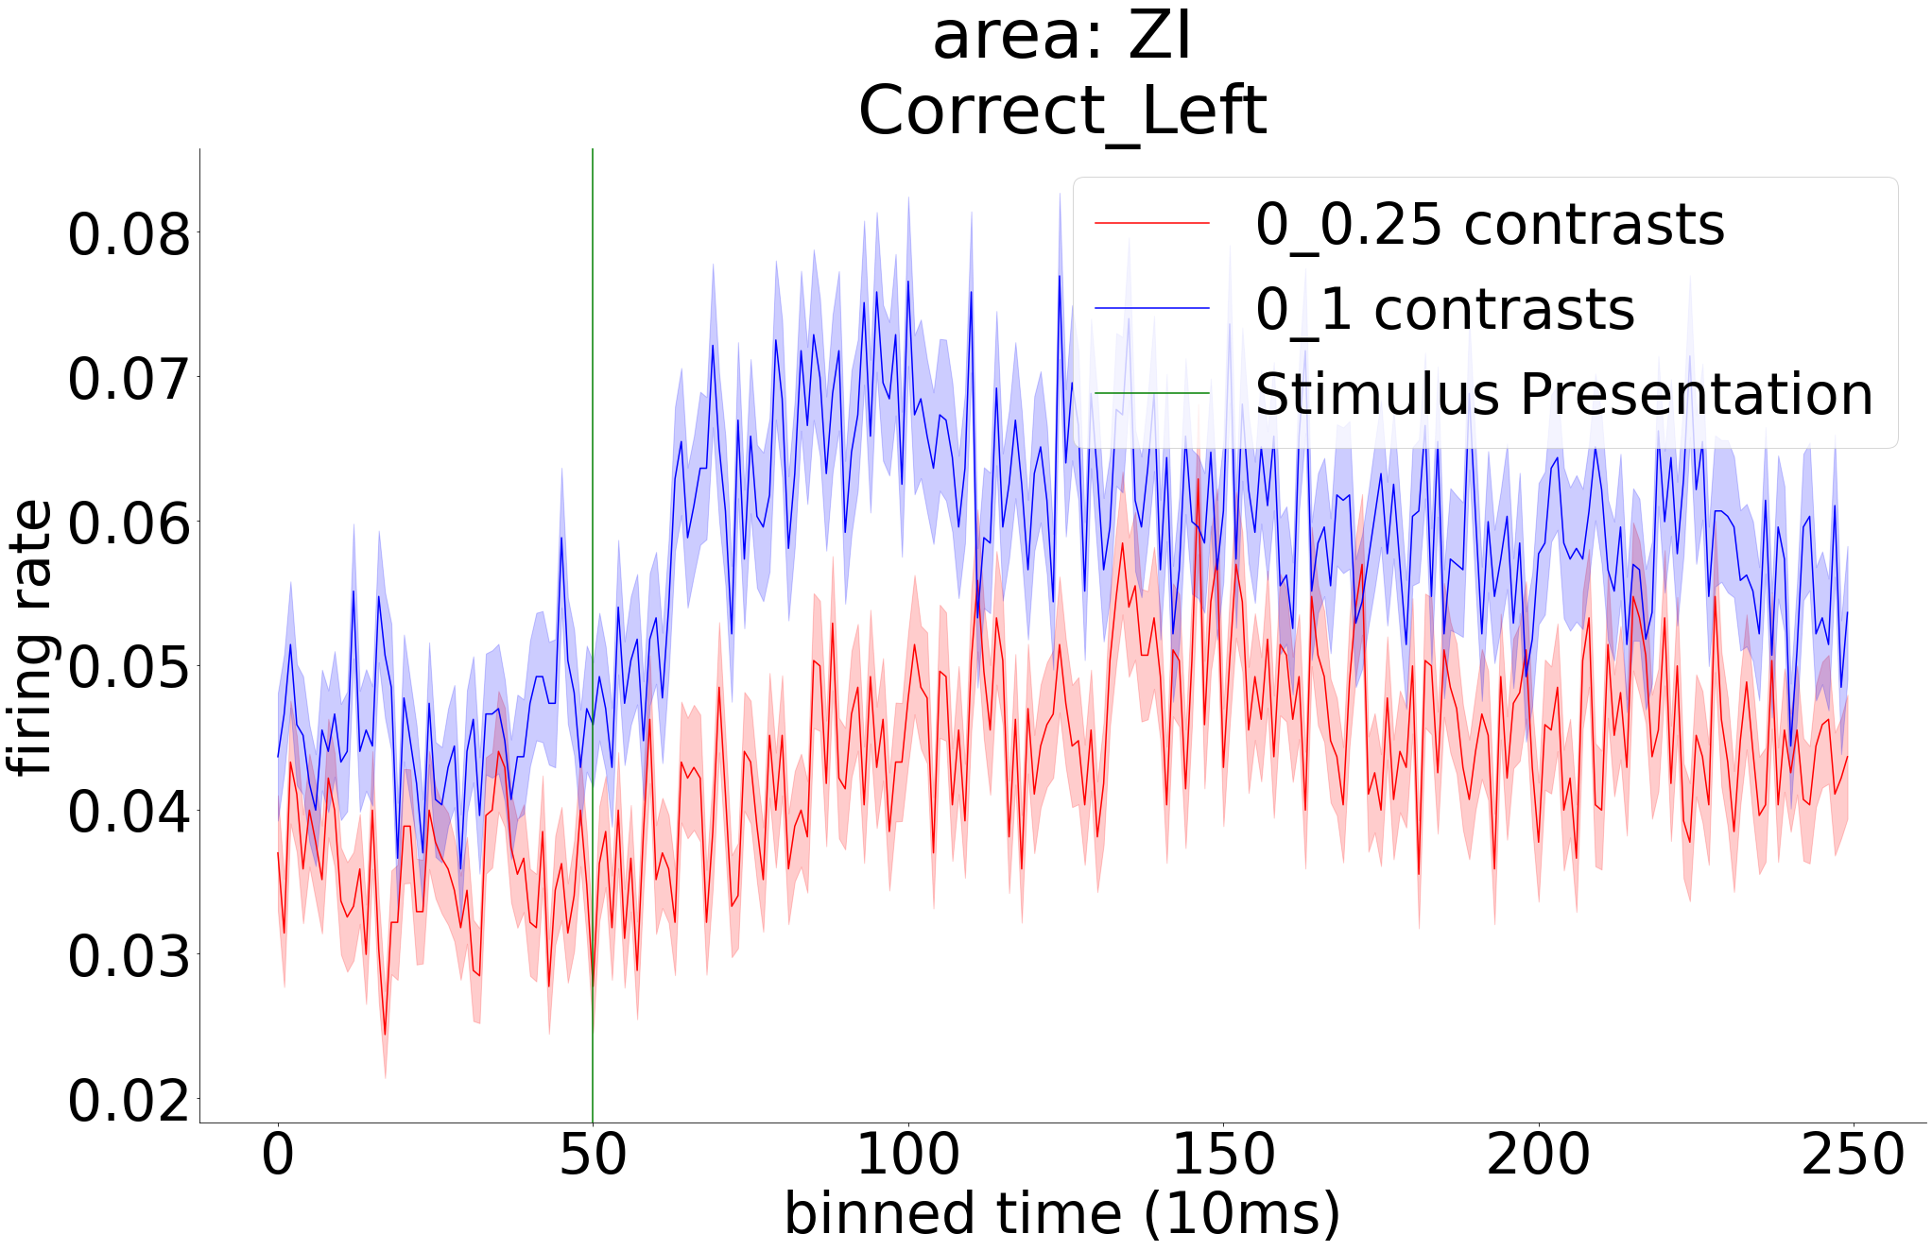
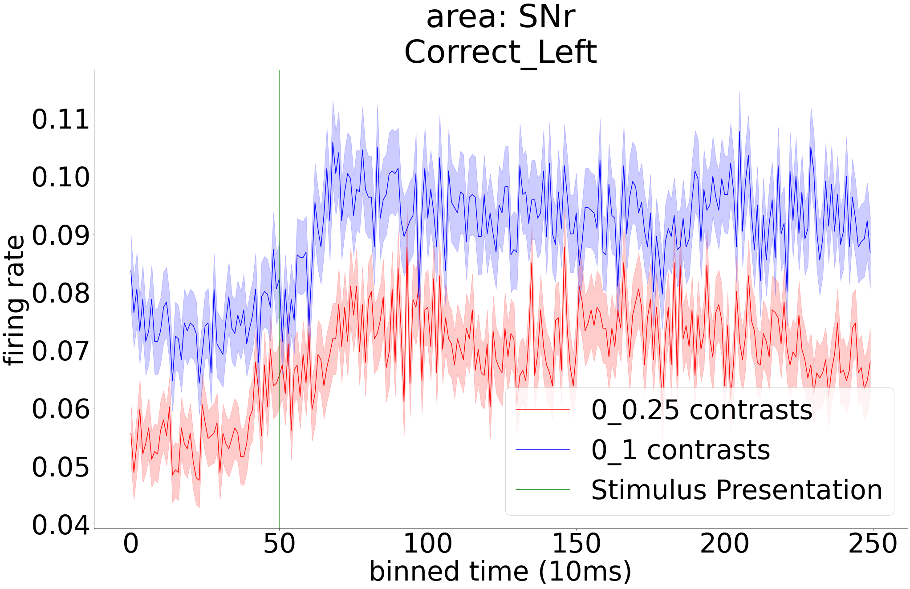
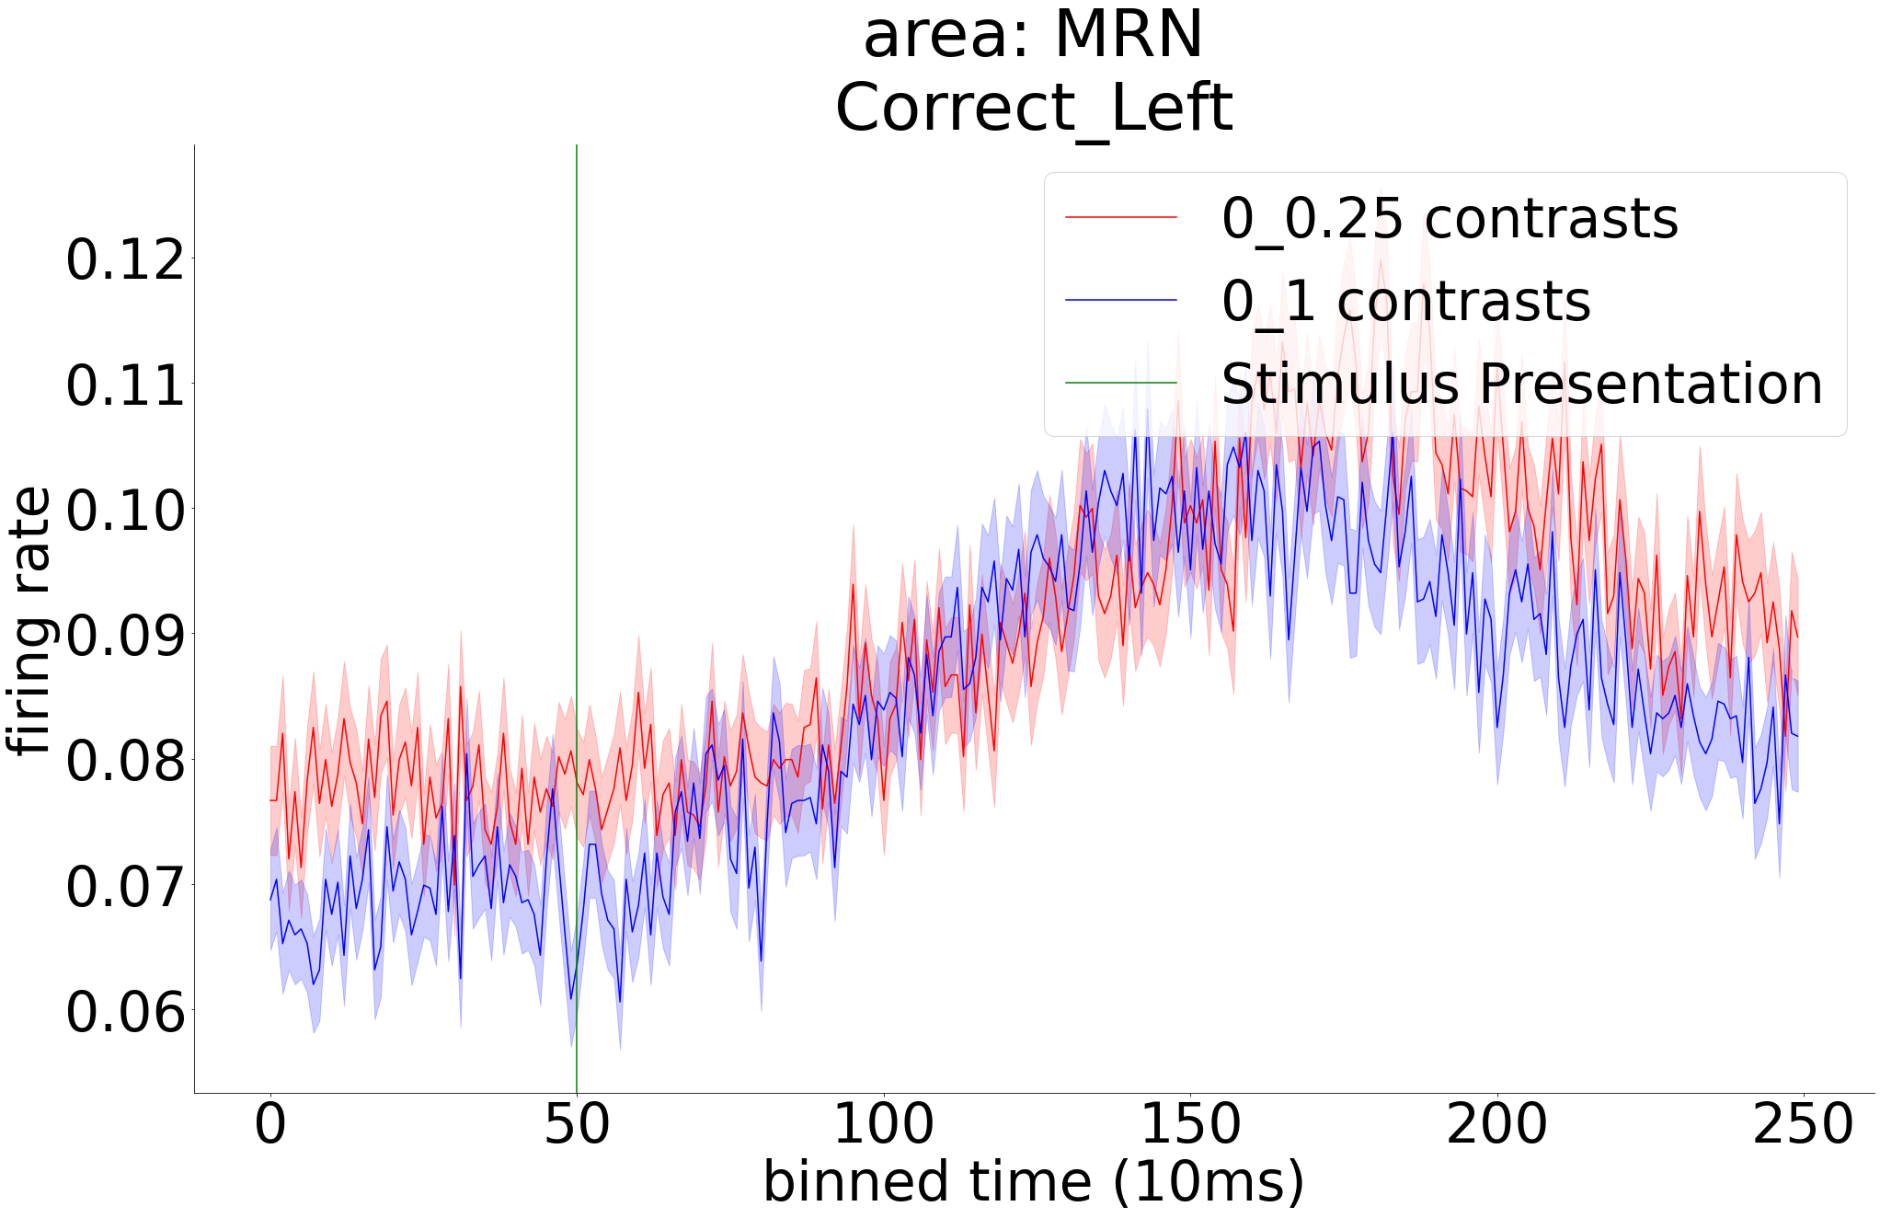
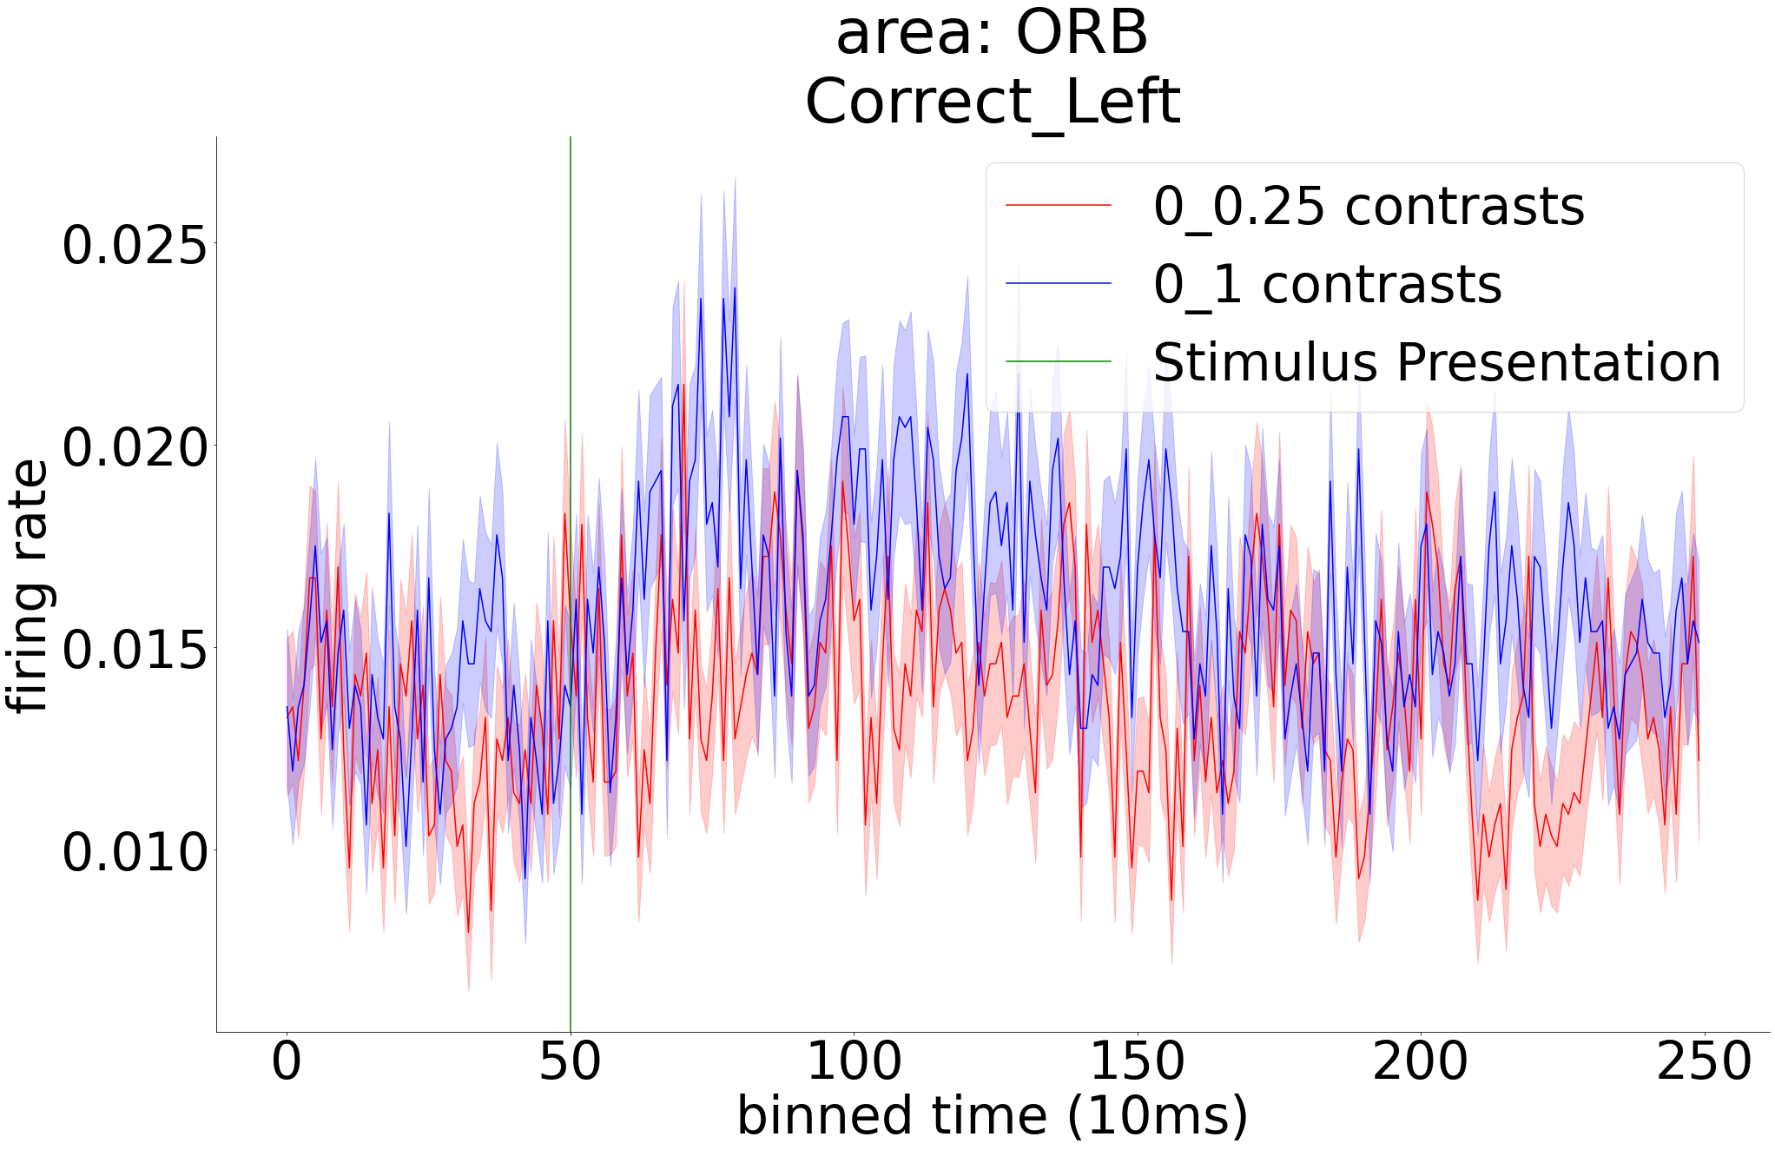
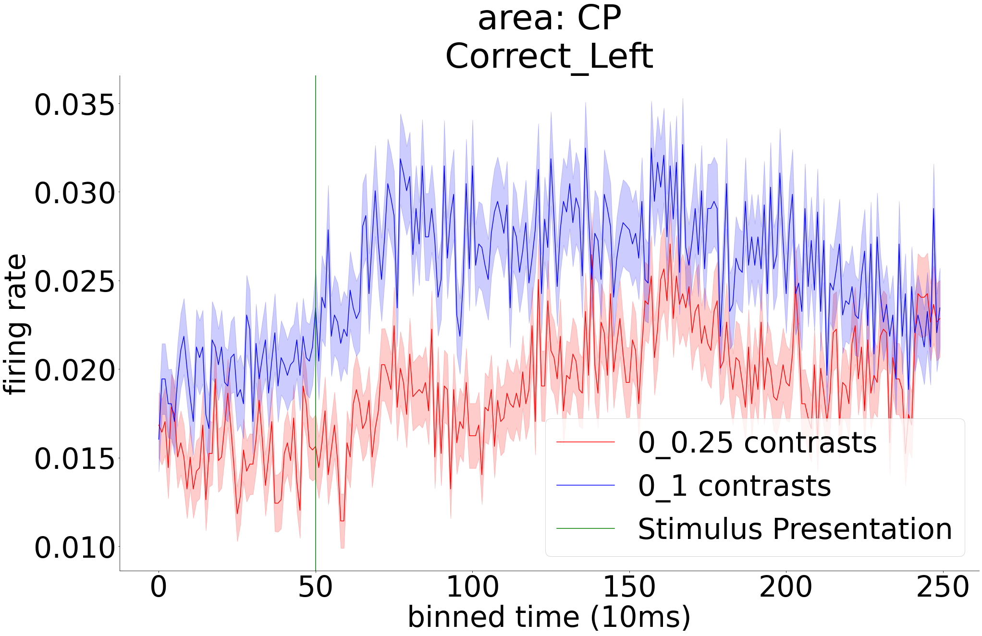
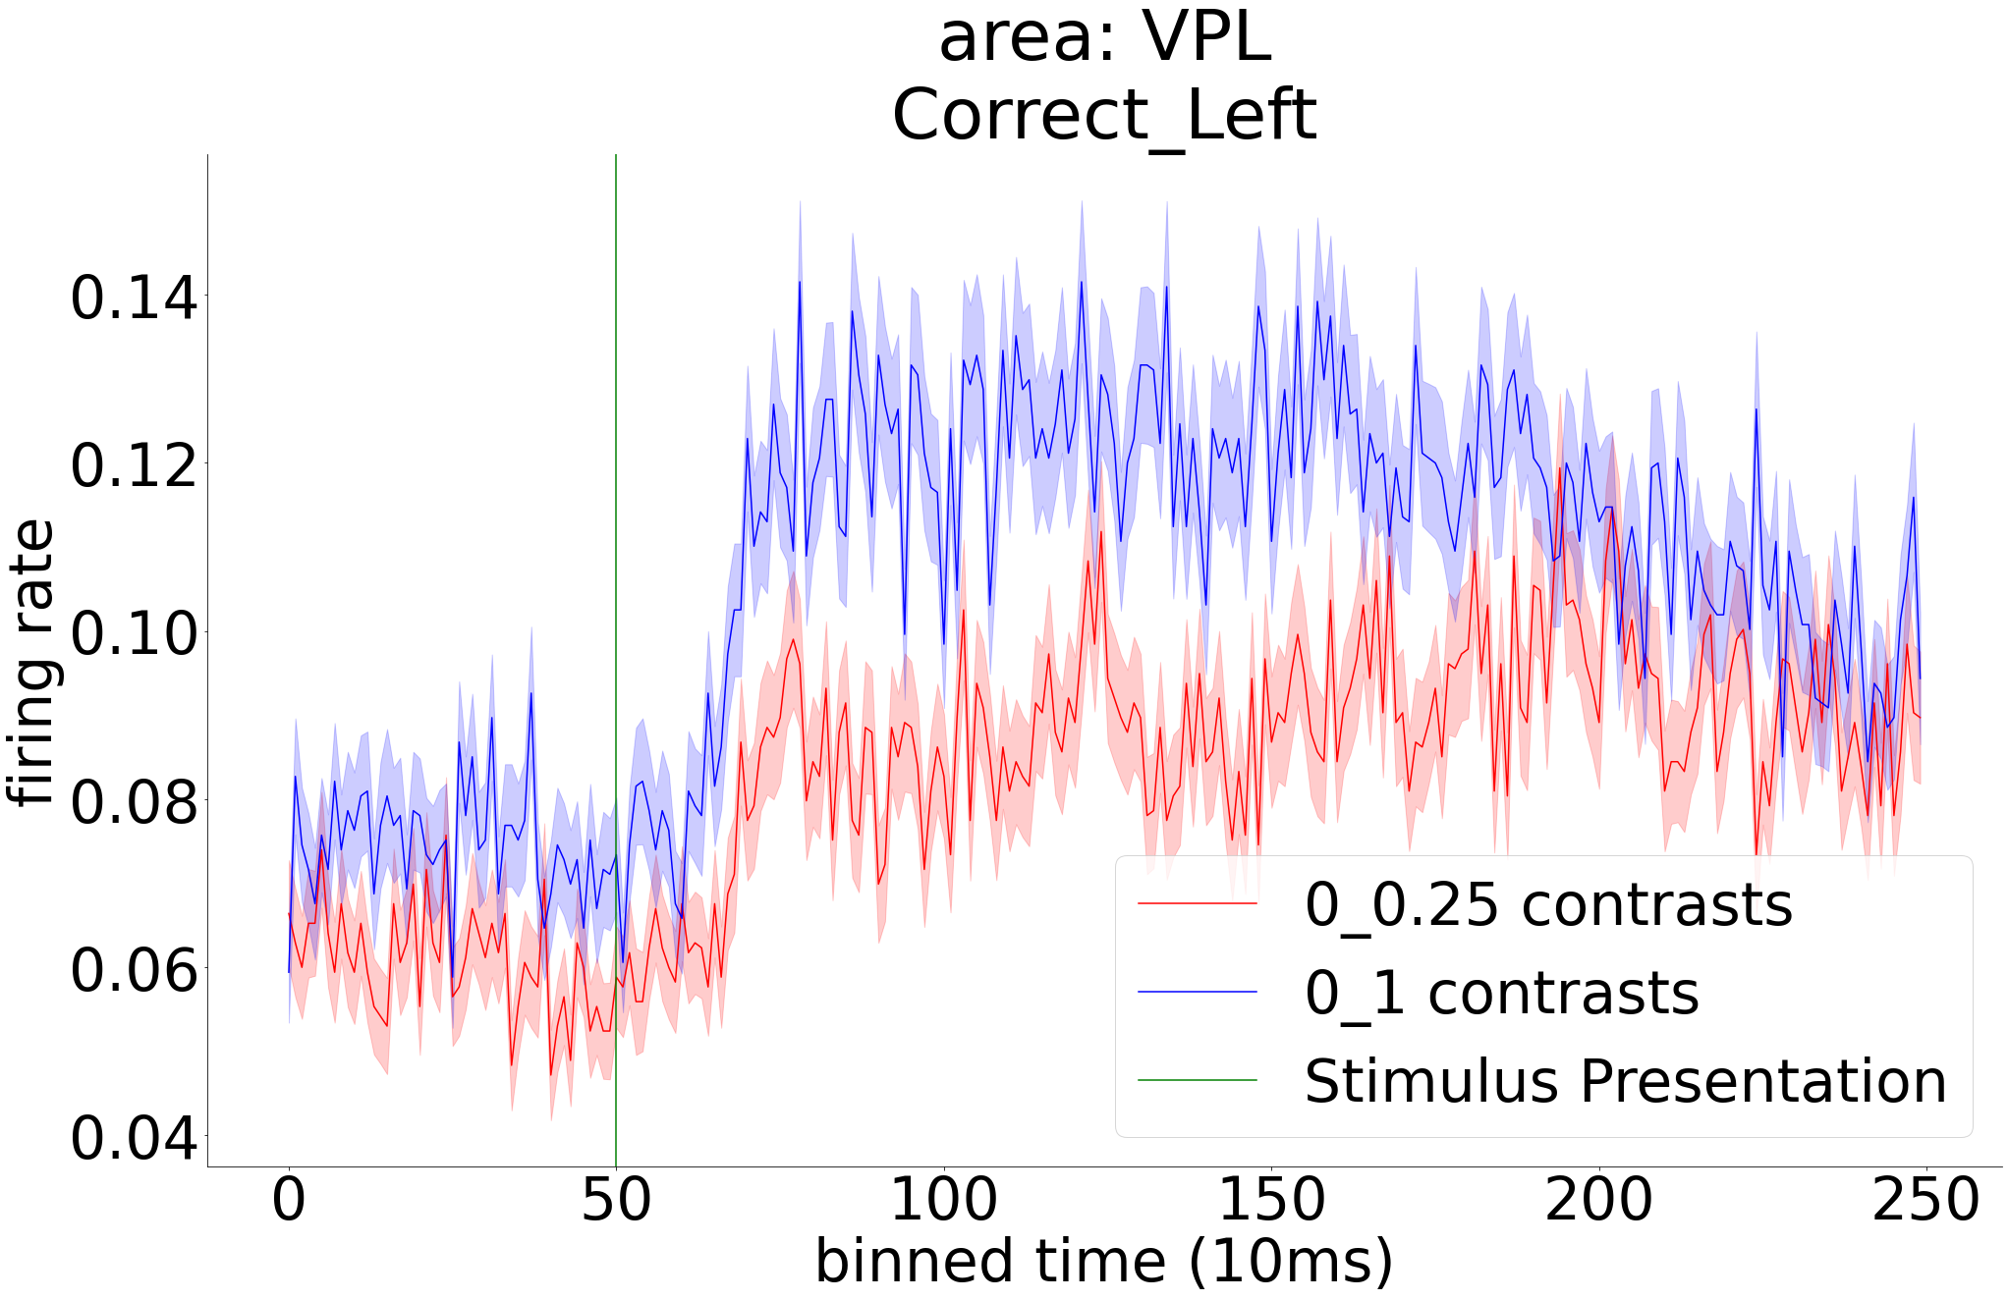
Frontal
Areas
Midbrain
Areas
Other
Areas

Slide 5
Future directions:
Modification of neural responses between 0-25 and 0-100 contrast levels could reflect factors other than uncertainty, such as:
1) Sensory effects : even though we only used ipsilateral trials to minimize sensory effects, it is still possible that some of our results are simply due a change of contrast between the 2 conditions. It is important to control for the average contrast level between the 2 conditions in order to properly study the effects of uncertainty.
2) Motor effects : the speed of the wheel is different between 0-25 and 0-100 contrast level conditions. It is indeed difficult to fully dissociate uncertainty representation from motor representation. Regression models can help dissociate the two factors. Alternatively, we can study the neural responses for different speeds of the wheel, using trials with the same contrast level. This analysis can help reveal how much of our current results are due to motor effects vs. uncertainty.

